Slide 1
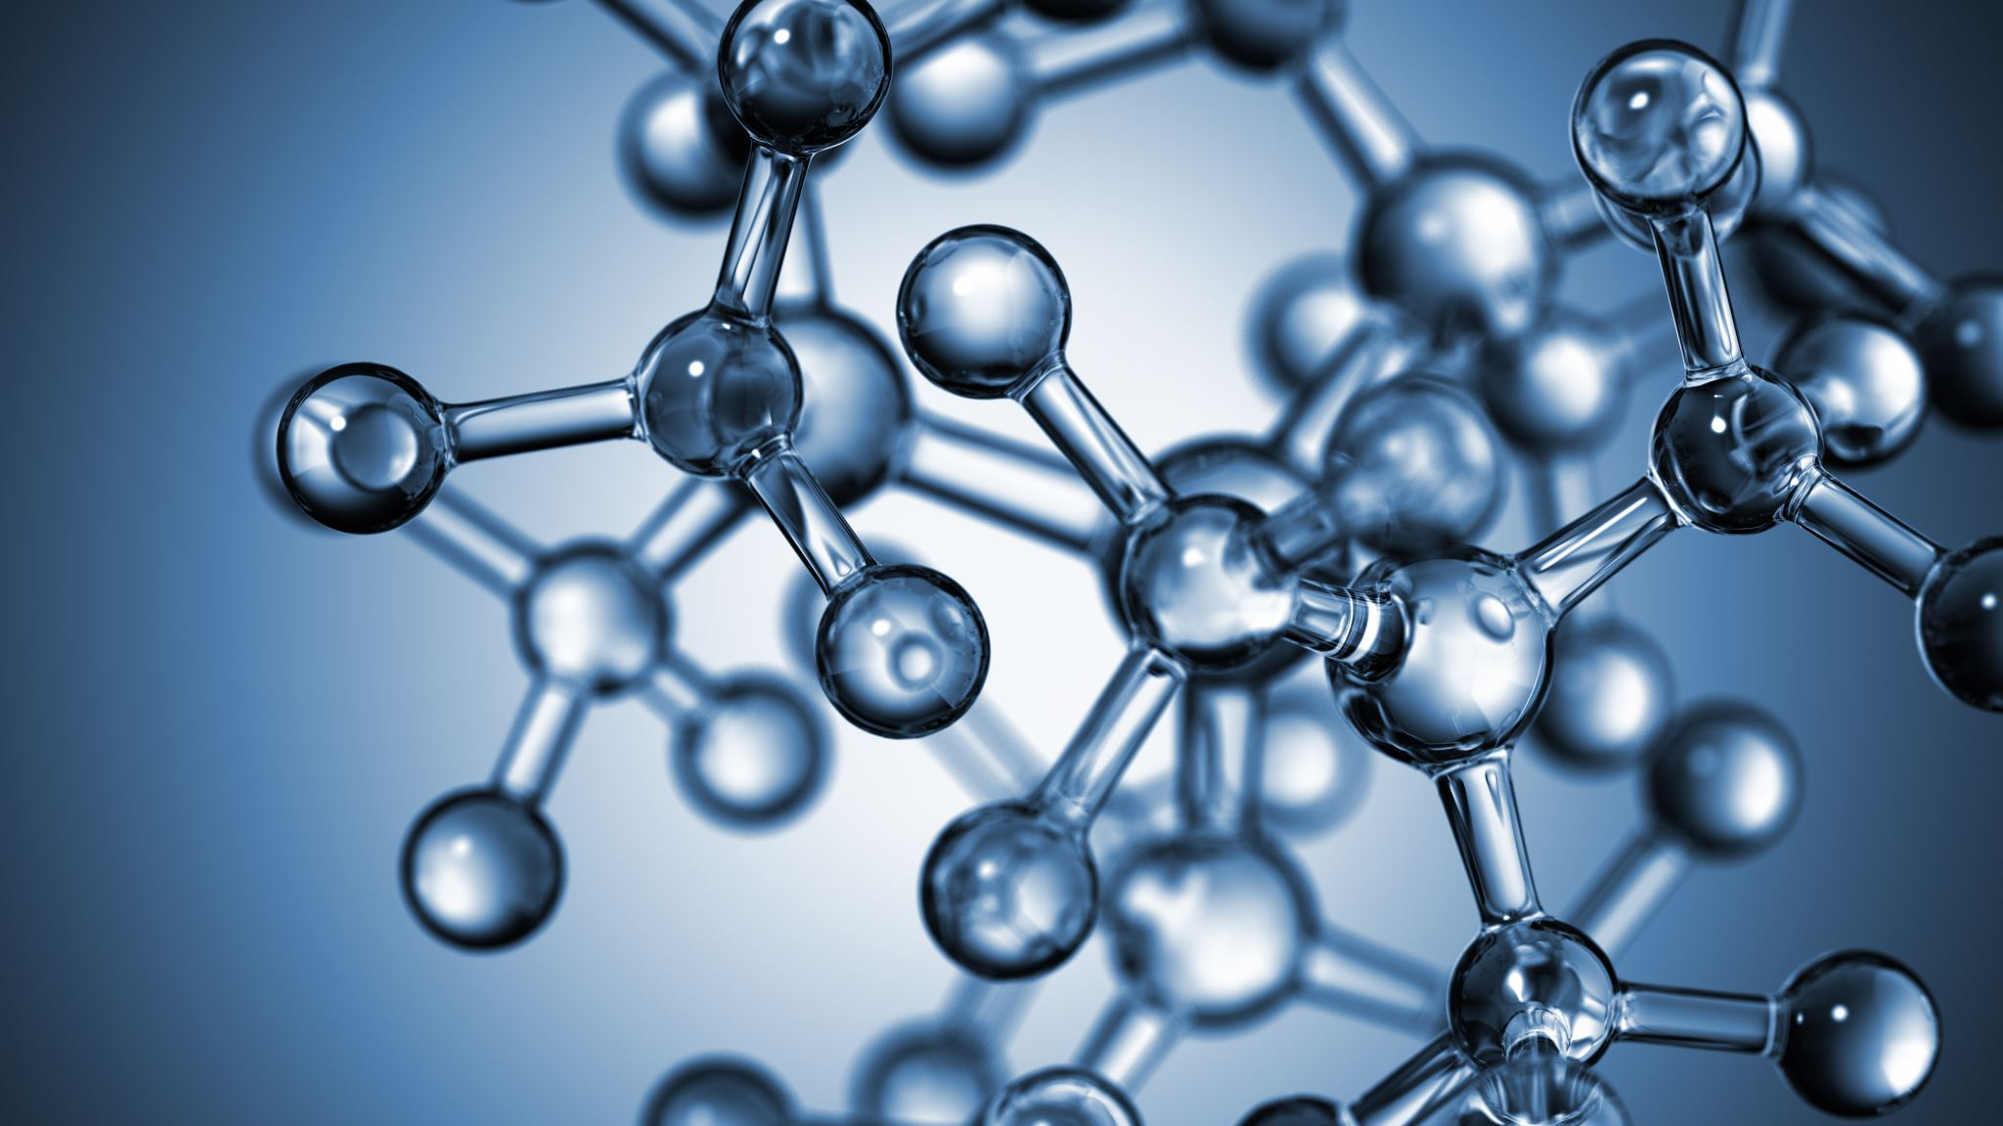


The basis of thermodynamics. Basic laws of chemical processes. First principles of thermodynamics.
Al-Farabi Kazakh National University
Faculty of Chemistry and Chemical technology
Department of General and Inorganic Chemistry
pHd Bakhadur askar

Slide 2
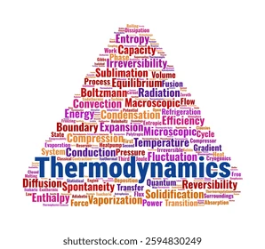
Introduction to thermodynamics
Thermodynamics is the branch of physical chemistry that studies the relationships between heat, work, and energy.
It provides a theoretical framework for understanding how energy is transformed during chemical and physical processes.
Thermodynamics is based on macroscopic observations and does not depend on atomic-level mechanisms.

Slide 3
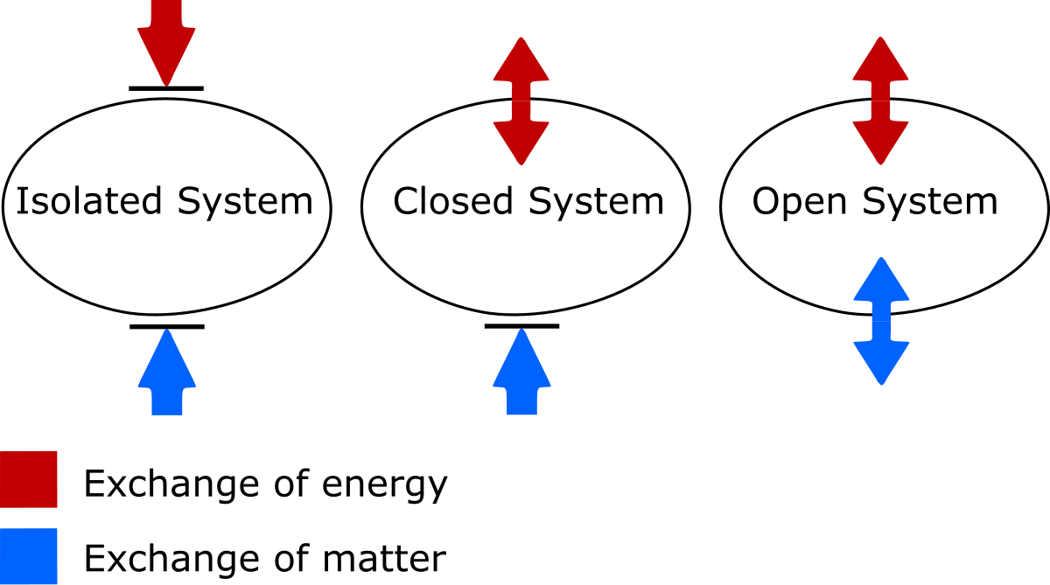
Basic concepts and definitions
System: the part of the universe under study (e.g., a chemical reaction in a vessel).
Surroundings: everything outside the system that can interact with it.
Boundary: separates the system from surroundings; can be open, closed, or isolated.
State variables: Pressure (P), Volume (V), Temperature (T), and Internal Energy (U).

Slide 4
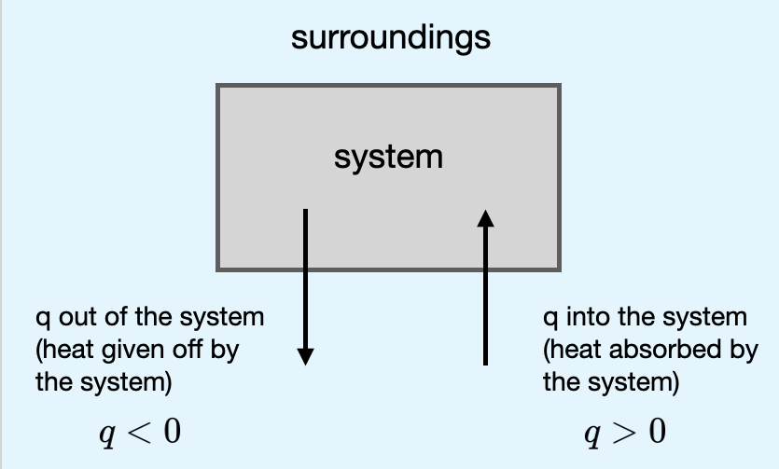
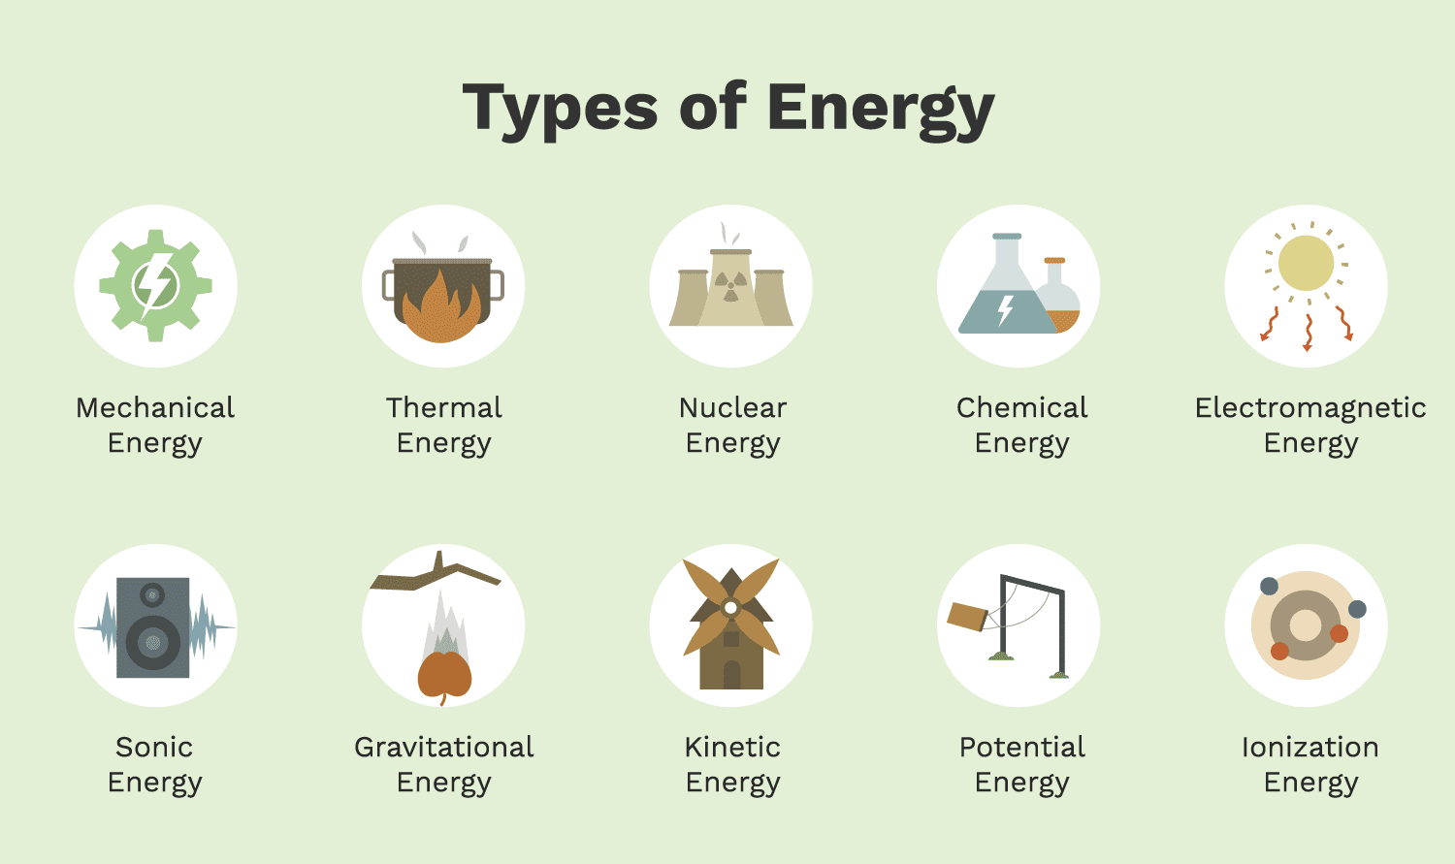
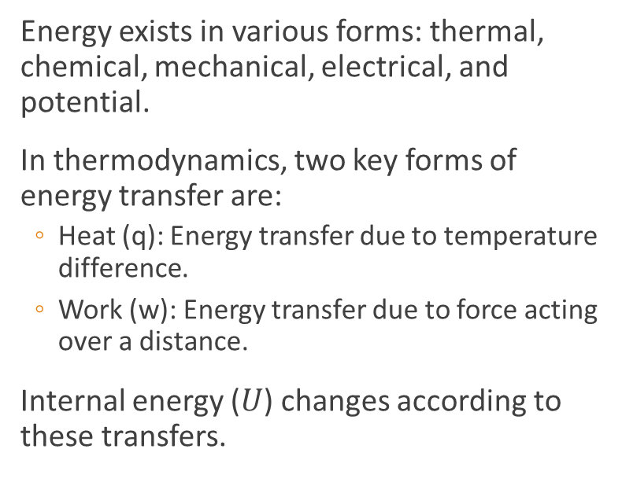
Forms of energy and work
Energy exists in various forms: thermal, chemical, mechanical, electrical, and potential.
In thermodynamics, two key forms of energy transfer are:
  Heat (q): Energy transfer due to temperature difference.
  Work (w): Energy transfer due to force acting over a distance.
Internal energy ($U$) changes according to these transfers.

Slide 5

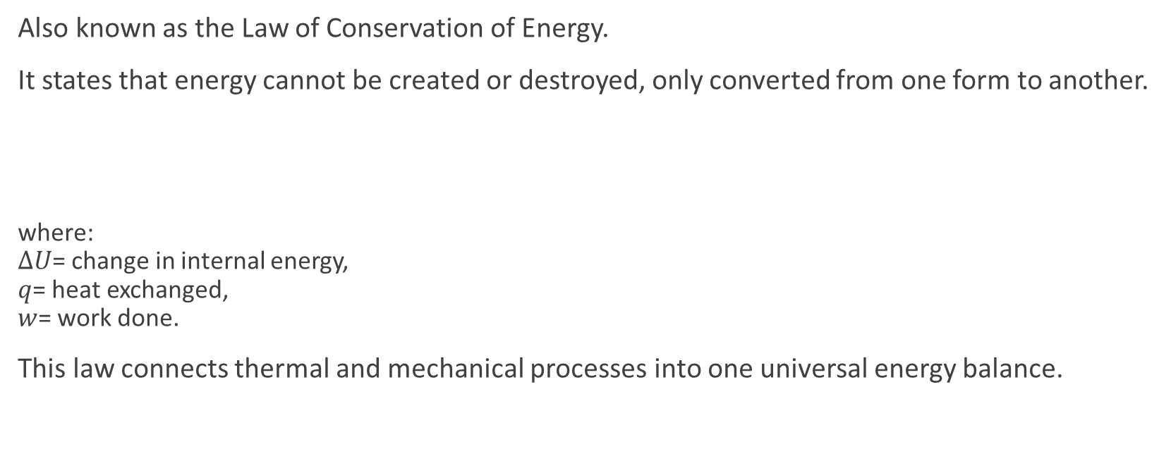
The first law of thermodynamics
Also known as the Law of Conservation of Energy.
It states that energy cannot be created or destroyed, only converted from one form to another.
where:
$ΔU$= change in internal energy,
$q$= heat exchanged,
$w$= work done.
This law connects thermal and mechanical processes into one universal energy balance.
$$ΔU=q+w$$

Slide 6
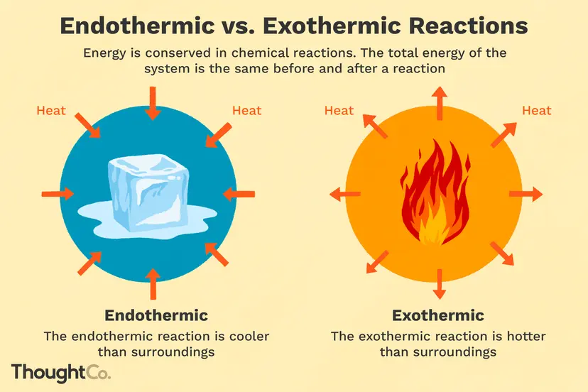


Applications in chemical processes
The first law explains energy changes during chemical reactions and phase transitions.
Exothermic reactions: release heat (negative $q$). example: combustion.
Endothermic reactions: absorb heat (positive $q$). example: photosynthesis.
Enthalpy (H): A useful thermodynamic function for processes at constant pressure:
Enthalpy changes describe heat exchange in chemical and physical transformations.
$$ΔH=ΔU+PΔV$$

Slide 7
Conclusion
Thermodynamics provides the foundation for understanding energy transformations in chemical systems.
The First Law ensures conservation of energy.
Thermodynamic concepts like enthalpy, entropy, and Gibbs free energy are key to predicting reaction spontaneity and equilibrium.
Understanding of thermodynamics is essential for studying chemical kinetics, materials science, and physical chemistry as a whole.

Slide 8

Questions?

